Slide 1



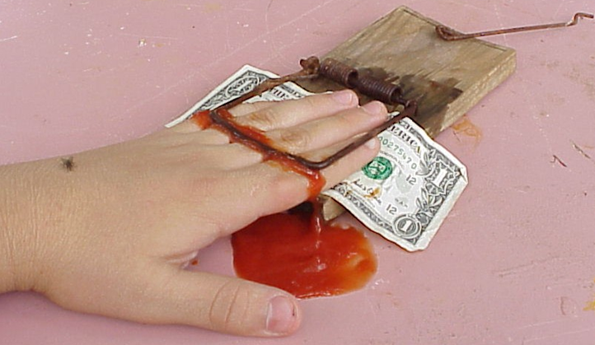
Greedy Algorithms
Optimal Substructure and Greedy Choice, Heuristic Algorithms
Greedy Algorithms
SoftUni Team
Technical Trainers
Software University
http://softuni.bg

Slide 2

Table of Contents
Greedy Algorithms – Concepts
Optimal Greedy Algorithms
Optimal Substructure and Greedy Choice
Max Coins, Sum of Coins, Activity Selection
Heuristic Algorithms
Notable Greedy Algorithms
A* Search

Slide 3

Greedy Algorithms
Picking Locally Optimal Solution

Slide 4
Optimization Problems
In computer science, an optimization problem is the problem of finding the best solution from all feasible solutions
Finding the optimal among many candidates
Examples of optimization problems:
Find the shortest path from Sofia to Varna on the map
Find the maximum increasing subsequence in integer sequence
Find the minimum spanning tree in weighted undirected graph
Traveling salesman problem (minimal Hamilton cycle)
Find the shortest route that visits each city and returns to the origin city

Slide 5
Greedy Algorithms
Greedy algorithms are a category of algorithms
For solving optimization problems
Usually more efficient than the other algorithms
But can produce non-optimal (incorrect) result
Greedy algorithms pick the best local solution
Pick the optimum from their current position & point of view
Greedy algorithms assume always choosing a local optimum leads to the global optimum
This is sometimes correct, but sometimes it is not

Slide 6

Greedy Algorithms: Example
The "Max Coins" game
You are given a set of coins
You play against another player, alternating turns
Per each turn, you can take up to three coins
Your goal is to have as many coins as possible at the end

Slide 7
Max Coins – Greedy Algorithm
A simple greedy strategy exists for the "Max Coins" game
Always choose the local maximum (at each step)
You don't consider what the other player does
You don't consider your actions' consequences
The greedy algorithm works optimally here
It plays the "Max Coins" game in an optimal way
It takes as many coins as possible
At each turn take the maximum number of coins

Slide 8
Greedy Algorithms: Another Example
Consider the US currency coins:
{ 0.01, 0.05, 0.10, 0.25, 0.50, 1.00 }
Problem "Sum of Coins":
Gather a sum of money, using the least possible number of coins
Assume you have infinite supplies of each coin
Greedy algorithm for "Sum of Coins":
Take the largest coin while possible
Then take the second largest
Etc.
1¢
10¢
50¢
5¢
25¢
1$

Slide 9
Sum of Coins – Greedy Algorithm
Greedy algorithm to make a sum with minimum number of coins
This works correctly for most 1-2-5 series-based currency systems
We want to achieve the sum S
We start with the sum Q = 0
We have a set of coins C = { 1, 5, 10 … }
At each step:
1) Pick the largest value V from C, such that Q + V ≤ S
2) Increase Q by V (add a coin of value V)
Repeat until Q == S

Slide 10

Greedy Algorithm for Sum of Coins
Live Coding Exercise (Lab)

Slide 11
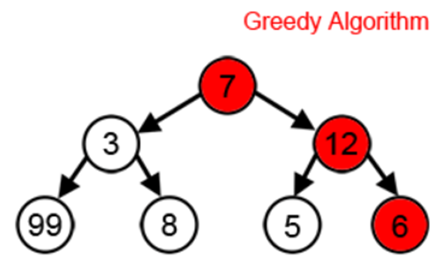
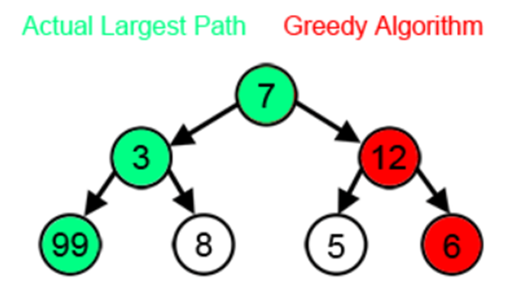
Greedy Failure Cases
Greedy algorithms are often non-optimal
Can even reach the unique worst possible solution for some problems
Example of non-optimal greedy:
Largest sum path in a tree (starting at root)
Greedy strategy: choose largest next node
Another example of non-working greedy:
Sum of coins: d = {4, 10, 25}; sum = 41
The greedy will fail to find a solution, which is 41 = 25 + 4 * 4

Slide 12

Optimal Greedy Algorithms
Optimal?
Greedy
Algorithms
Optimal Substructure and Greedy Choice Property

Slide 13
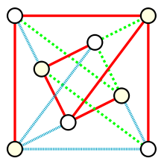
Optimal Greedy Algorithms
Suitable problems for greedy algorithms have these properties:
Greedy choice property
Optimal substructure
Any problem having the above properties
Guaranteed to have an optimal greedy solution
Matroids – a way to prove greedy optimality
If a problem has the properties of a matroid, it is guaranteed to have an optimal greedy solution

Slide 14
Greedy Choice Property
Greedy choice property
A global optimal solution can be obtained by greedily selecting a locally optimal choice
Sub-problems that arise are solved by consequent greedy choices
Enforced by optimal substructure
Example of greedy choice:
The smallest-weight edge always takes part in the minimum spanning tree (MST)
17
F
14
A
J
10
6
13
11
16
K
D
33
G
26
12
4
9
20
E
14
C
22
H

Slide 15
Optimal Substructure Property
Optimal substructure property
After each greedy choice the problem remains an optimization problem of the same form as the original problem
An optimal global solution contains the optimal solutions of all its sub-problems
Example of optimal substructure:
After removing the smallest-weight edge (and merging its nodes), we get a MST problem of the same form
17
F
14
A
J
6
13
11
16
10
DE
33
G
K
26
12
9
20
14
22
C
H

Slide 16
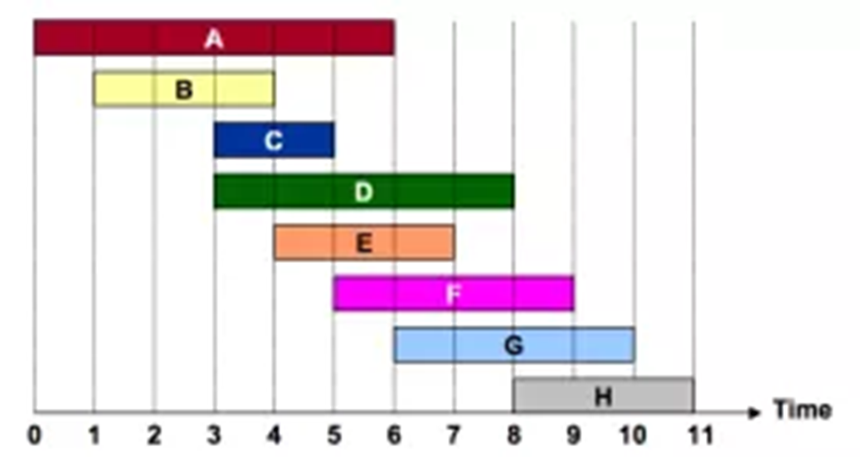
Activity Selection Problem
The Greedy Algorithm and Why It Is Optimal

Slide 17
Activity Selection Problem
The Activity Selection Problem (a.k.a. Conference Scheduling Problem)
Given a set of activities S = {a₁, a₂, …, a_{n}}
Each having a start & finish time: a_{i} = {s_{i}, f_{i}}
Activities are "compatible" if they don't overlap
i.e. their intervals do not intersect
What is the maximum-size subset of compatible activities?
i.e. which is the largest list of compatible activities that can be scheduled?

Slide 18
Activity Selection Problem – Example
Activity selection problem example:
Several optimal solutions: {a₁, a₄, a₈, a₁₁}, {a₂, a₄, a₉, a₁₁}, …
Index | 1 | 2 | 3 | 4 | 5 | 6 | 7 | 8 | 9 | 10 | 11
Start (s_{i}) | 1 | 3 | 0 | 5 | 3 | 5 | 6 | 8 | 8 | 2 | 12
Finish (f_{i}) | 4 | 5 | 6 | 7 | 8 | 9 | 10 | 11 | 12 | 13 | 14
0
1
2
3
4
5
6
7
8
9
10
11
12
13
14
15

Slide 19
Activity Selection Problem: Greedy
A greedy algorithm for the Activity Selection Problem:
Greedy characteristics of the above algorithm
Taking the earliest finish activity gives more time for all others
We pick an activity preserving the "maximum remaining time"
While (S in not empty)
Select from S an activity A with the earliest finish
Remove A + all activities from S conflicting with A

Slide 20
Activity Selection Problem: Implementation
Single scan (linear) implementation of the greedy algorithm for the Activity Selection Problem:
Sort the activities from S by their finish time
last = first activity from S
for (a in S)
if (a.Start >= last.Finish)
// a does not conflict with last
print a
last = a

Slide 21
Proving Greedy Optimality
To prove the discussed greedy is optimal we:
Need to prove the problem has a greedy choice property
Need to prove the problem has optimal substructure
Greedy properties are satisfied:
A solution starting with a greedy choice exists: the earliest finish
Optimal substructure exists:
If we remove the activity A with the earliest finish time activity
We reduce the problem to the same problem of smaller size (without activities in S, which intersect the activity A)

Slide 22
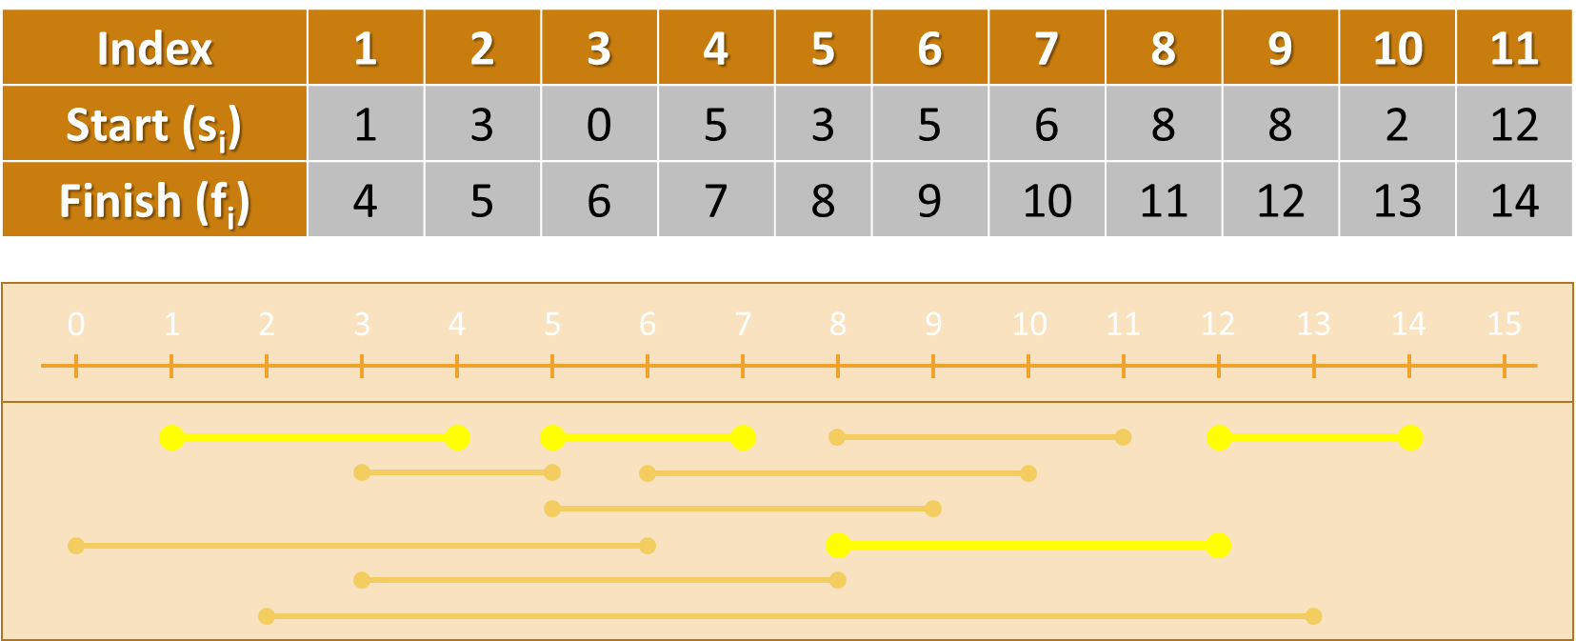
Activity Selection Problem
Live Demo

Slide 23
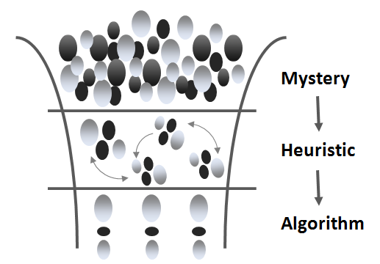
Heuristic Algorithms
Greedy, Randomized, Genetic, Others

Slide 24
Heuristic Algorithms
Some problems are hard to be solved (no fast algorithm exists)
Heuristic algorithms solve hard problems approximately
They find a good solution, but cannot guarantee it is optimal
Examples of heuristic algorithms:
Greedy algorithms – make a greedy choice at each step
Randomized algorithms – choose randomly and approximate
Genetic algorithms – based on inheritance, mutation, selection, …
Branch and bounds – optimized backtracking with cut-offs
Minimax algorithms – minimizing the possible loss for a worst case

Slide 25
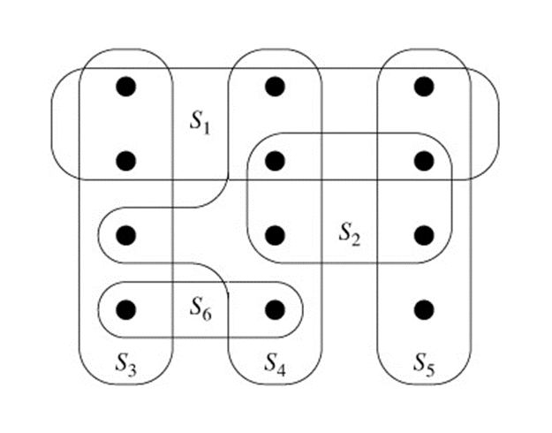
The Set Cover Problem
Using Greedy for Approximation

Slide 26
Set Cover Problem
The Set Cover Problem (SCP) is such a problem
SCP formulation:
Given a set U={1,2,…,m} called "the Universe"
And a set S={{…}, {…}, {…}, …} of n sets whose union = U
Find the smallest subset of S, the union of which = U (if it exists)
Example of SCP:
U = {1, 2, 3, 4, 5, 6}
S = { {1, 3}, {1}, {2, 4}, {2, 5}, {2, 6}, {2, 3, 6}, {4, 6}, {4, 5, 6}, {6} }

Slide 27
Set Cover Problem
The SCP turns out very complex!
The optimal solution is NP-complete
Infeasible for real-world calculations (unless P = NP)
Good solutions can be achieved through a greedy approach:
At each step pick the set containing the largest number of uncovered elements, e. g.
U = {1, 2, 3, 4, 5, 6}
S = { {1, 3}, {1}, {2, 4}, {2, 5}, {2, 6}, {2, 3, 6}, {4, 6}, {4, 5, 6}, {6} }

Slide 28
The Set Cover Problem
Live Coding Exercise (Lab)

Slide 29

Notable Greedy Algorithms

Slide 30
Notable Greedy Algorithms: Dijkstra
Dijkstra's algorithm for finding the shortest path between two vertices in weighted graph (with no negative edges)
Greedy choice: at each step, of all reached edges, pick
The one that, along with the path to it, constitutes a minimal sum
Optimal substructure: the unreached edges can be considered as a smaller problem of the same form
The algorithm is proven optimal
Immediately after it reaches a vertex, the path generated to it is guaranteed to be optimal

Slide 31
Notable Greedy Algorithms: Prim & Kruskal
Prim and Kruskal's algorithms for a minimum spanning tree (MST) are greedy algorithms
Prim:
Pick the smallest edge, not in the MST so far
Kruskal:
Pick the smallest edge, connecting two vertices, not in the same tree
Both algorithms hold the greedy choice and optimal substructure properties

Slide 32
Notable Greedy Algorithms: A*
The A* pathfinding algorithm is a modification of Dijkstra's shortest path algorithm
At each step it uses a heuristic function to guide its search
g-cost(n) – the distance from n to the start node
h-cost(n) – the distance from n to the destination node
Traverses the nodes with lowest f-cost first
Updates the f-costs of their neighbors
f-cost(n) = g-cost(n) + h-cost(n)

Slide 33
A* Shortest Path: Step #1
Start traversal by putting A in priority queue
 | 0 | 1 | 2 | 3 | 4 | 5 | 6 | 7 | 8 | 9 | 10
0
1 |  |  |  |  | B
2
3
4 |  |  |  |  |  |  |  | A
5

Slide 34
A* Shortest Path: Step #2
Enqueue all non-visited adjacent cells
 | 0 | 1 | 2 | 3 | 4 | 5 | 6 | 7 | 8 | 9 | 10
0
1 |  |  |  |  | B
2
3
4 |  |  |  |  |  |  |  | A
5
g-cost
h-cost
14 28
14
28
10
38
14
48
42
48
62
42
10
38
10
52
48
62
14
48
10
52
14
56
f-cost
62
62
70

Slide 35
A* Shortest Path: Step #3
Visit the cell with lowest f-cost of 42 (cell 3, 6)
Enqueue non-visited adjacent cells
 | 0 | 1 | 2 | 3 | 4 | 5 | 6 | 7 | 8 | 9 | 10
0
1 |  |  |  |  | B
2
3
4 |  |  |  |  |  |  |  | A
5
24
24
14
28
10
38
14
48
48
42
48
62
28
34
10
38
10
52
62
48
62
14
48
10
52
14
56
62
62
70

Slide 36
A* Shortest Path: Step #4
There are several nodes with the lowest f-cost 48
Choose the one with lowest h-cost (cell 3,5)
 | 0 | 1 | 2 | 3 | 4 | 5 | 6 | 7 | 8 | 9 | 10
0
1 |  |  |  |  | B
2
3
4 |  |  |  |  |  |  |  | A
5
34
20
24
24
14
28
10
38
14
48
54
48
42
48
62
38
30
28
34
10
38
10
52
68
62
48
62
14
48
10
52
14
56
62
62
70

Slide 37
A* Shortest Path: Step #5
Visit cell 3,7
 | 0 | 1 | 2 | 3 | 4 | 5 | 6 | 7 | 8 | 9 | 10
0
1 |  |  |  |  | B
2
3
4 |  |  |  |  |  |  |  | A
5
24
44
68
34
20
24
24
14
28
10
38
14
48
54
48
42
48
62
38
30
28
34
10
38
10
52
68
62
48
62
14
48
10
52
14
56
62
62
70

Slide 38
A* Shortest Path: Step #6
Visit cell 4,6
Update the g-cost of its adjacent cell 4,5
We just found a shorter path from start to that cell
 | 0 | 1 | 2 | 3 | 4 | 5 | 6 | 7 | 8 | 9 | 10
0
1 |  |  |  |  | B
2
3
4 |  |  |  |  |  |  |  | A
5
24
44
68
34
20
24
24
14
28
10
38
14
48
54
48
42
48
62
38
30
20
34
10
38
10
52
68
54
48
62
24
44
14
48
10
52
14
56
68
62
62
70

Slide 39
A* Shortest Path: Step #7
Visit cell 3,4
 | 0 | 1 | 2 | 3 | 4 | 5 | 6 | 7 | 8 | 9 | 10
0
1 |  |  |  |  | B
2
3
4 |  |  |  |  |  |  |  | A
5
24
44
68
44
24
34
20
24
24
14
28
10
38
14
48
68
54
48
42
48
62
48
34
38
30
20
34
10
38
10
52
82
68
54
48
62
24
44
14
48
10
52
14
56
68
62
62
70

Slide 40
A* Shortest Path: Step #8
Visit cell 4,5
Update g-cost of adjacent cell 4,4
 | 0 | 1 | 2 | 3 | 4 | 5 | 6 | 7 | 8 | 9 | 10
0
1 |  |  |  |  | B
2
3
4 |  |  |  |  |  |  |  | A
5
24
44
68
44
24
34
20
24
24
14
28
10
38
14
48
68
54
48
42
48
62
48
34
30
30
20
34
10
38
10
52
82
60
54
48
62
34
40
24
44
14
48
10
52
14
56
74
68
62
62
70

Slide 41
A* Shortest Path: Step #9
Visit cell 4,4
 | 0 | 1 | 2 | 3 | 4 | 5 | 6 | 7 | 8 | 9 | 10
0
1 |  |  |  |  | B
2
3
4 |  |  |  |  |  |  |  | A
5
24
44
68
44
24
34
20
24
24
14
28
10
38
14
48
68
54
48
42
48
62
40
34
30
30
20
34
10
38
10
52
74
60
54
48
62
44
44
34
40
24
44
14
48
10
52
14
56
88
74
68
62
62
70

Slide 42
A* Shortest Path: Step #10
Visit cell 3,8
 | 0 | 1 | 2 | 3 | 4 | 5 | 6 | 7 | 8 | 9 | 10
0
1 |  |  |  |  | B
2
3
4 |  |  |  |  |  |  |  | A
5
24
44
28
54
68
82
44
24
34
20
24
24
14
28
10
38
14
48
24
58
68
54
48
42
48
62
82
40
34
30
30
20
34
10
38
10
52
28
62
74
60
54
48
62
90
44
44
34
40
24
44
14
48
10
52
14
56
88
74
68
62
62
70

Slide 43
A* Shortest Path: Step #11
Visit cell 5,6
 | 0 | 1 | 2 | 3 | 4 | 5 | 6 | 7 | 8 | 9 | 10
0
1 |  |  |  |  | B
2
3
4 |  |  |  |  |  |  |  | A
5
24
44
28
54
68
82
44
24
34
20
24
24
14
28
10
38
14
48
24
58
68
54
48
42
48
62
82
40
34
30
30
20
34
10
38
10
52
28
62
74
60
54
48
62
90
44
44
34
40
24
44
14
48
10
52
14
56
88
74
68
62
62
70

Slide 44
A* Shortest Path: Step #12
Visit cell 5,7
 | 0 | 1 | 2 | 3 | 4 | 5 | 6 | 7 | 8 | 9 | 10
0
1 |  |  |  |  | B
2
3
4 |  |  |  |  |  |  |  | A
5
24
44
28
54
68
82
44
24
34
20
24
24
14
28
10
38
14
48
24
58
68
54
48
42
48
62
82
40
34
30
30
20
34
10
38
10
52
28
62
74
60
54
48
62
90
44
44
34
40
24
44
14
48
10
52
14
56
88
74
68
62
62
70

Slide 45
A* Shortest Path: Step #13
Visit cell 4,8
Update g-cost of adjacent cell 4,9
 | 0 | 1 | 2 | 3 | 4 | 5 | 6 | 7 | 8 | 9 | 10
0
1 |  |  |  |  | B
2
3
4 |  |  |  |  |  |  |  | A
5
24
44
28
54
68
82
44
24
34
20
24
24
14
28
10
38
14
48
24
58
68
54
48
42
48
62
82
40
34
30
30
20
34
10
38
10
52
20
62
74
60
54
48
62
82
44
44
34
40
24
44
14
48
10
52
14
56
24
66
88
74
68
62
62
70
90

Slide 46
A* Shortest Path: Step #14
Visit cell 2,8
 | 0 | 1 | 2 | 3 | 4 | 5 | 6 | 7 | 8 | 9 | 10
0
1 |  |  |  |  | B
2
3
4 |  |  |  |  |  |  |  | A
5
38
30
34
40
38
50
68
74
88
24
44
28
54
68
82
44
24
34
20
24
24
14
28
10
38
14
48
24
58
68
54
48
42
48
62
82
40
34
30
30
20
34
10
38
10
52
20
62
74
60
54
48
62
82
44
44
34
40
24
44
14
48
10
52
14
56
24
66
88
74
68
62
62
70
90

Slide 47
A* Shortest Path: Step #15
Visit cell 1,7
 | 0 | 1 | 2 | 3 | 4 | 5 | 6 | 7 | 8 | 9 | 10
0
1 |  |  |  |  | B
2
3
4 |  |  |  |  |  |  |  | A
5
52
24
48
34
52
44
76
82
96
48
20
38
30
34
40
38
50
68
68
74
88
24
44
28
54
68
82
44
24
34
20
24
24
14
28
10
38
14
48
24
58
68
54
48
42
48
62
82
40
34
30
30
20
34
10
38
10
52
20
62
74
60
54
48
62
82
44
44
34
40
24
44
14
48
10
52
14
56
24
66
88
74
68
62
62
70
90

Slide 48
A* Shortest Path: Step #16
Visit cell 1,6
 | 0 | 1 | 2 | 3 | 4 | 5 | 6 | 7 | 8 | 9 | 10
0
1 |  |  |  |  | B
2
3
4 |  |  |  |  |  |  |  | A
5
62
14
52
24
48
34
52
44
76
76
82
96
58
10
48
20
38
30
34
40
38
50
68
68
68
74
88
24
44
28
54
68
82
44
24
34
20
24
24
14
28
10
38
14
48
24
58
68
54
48
42
48
62
82
40
34
30
30
20
34
10
38
10
52
20
62
74
60
54
48
62
82
44
44
34
40
24
44
14
48
10
52
14
56
24
66
88
74
68
62
62
70
90

Slide 49
A* Shortest Path: Step #17
Visit cell 1,5
Found our destination cell → over
 | 0 | 1 | 2 | 3 | 4 | 5 | 6 | 7 | 8 | 9 | 10
0
1 |  |  |  |  | B
2
3
4 |  |  |  |  |  |  |  | A
5
62
14
52
24
48
34
52
44
76
76
82
96
58
10
48
20
38
30
34
40
38
50
68
68
68
74
88
24
44
28
54
68
82
44
24
34
20
24
24
14
28
10
38
14
48
24
58
68
54
48
42
48
62
82
40
34
30
30
20
34
10
38
10
52
20
62
74
60
54
48
62
82
44
44
34
40
24
44
14
48
10
52
14
56
24
66
88
74
68
62
62
70
90

Slide 50





A* Shortest Path: Reconstruction
If we have a prev[] array and keep at each cell where we came from, we can reconstruct the path
58
10
48
20
38
30
68
68
68
24
44
68
10
38
48

Slide 51
A* Pseudo Code
openSet = non-visited nodes ordered by f-cost (h-Cost + g-Cost)
closedSet = visited nodes
hCost[0..n-1] = MAX_INT
gCost[0..n-1] = MAX_INT
previous[0..n-1] = NULL
startNode → openSet
gCost[startNode] = 0
while (openSet is not empty)
node = remove min from openSet
node → closedSet
if (node == destination) stop
(example continues)

Slide 52
A* Pseudo Code (2)
for each neighbor in GetNeighbors(node)
if (neighbor ∈ closedSet) skip
newGCost = gCost(node) + GetDistance(neighbor, node)
if (newGCost < gCost[neighbor])
gCost[neighbor] = newGCost
hCost[neighbor] = GetDistance(neighbor, destination)
previous[neighbor] = node
if (neighbor ∉ openSet)
neighbor → openset
else
reorder openSet
end while

Slide 53
A* Pseudo Code: Heuristic
A sample heuristic function for calculating direct distance:
Going diagonally has a cost of 14, going straight – cost of 10
int GetDistance(x1, y1, x2, y2)
deltaX = abs(x1 – x2)
deltaY = abs(y1 – y2)
if (deltaX > deltaY)
return 14 * deltaY + 10 * (deltaX – deltaY)
else
return 14 * deltaX + 10 * (deltaY – deltaX)

Slide 54
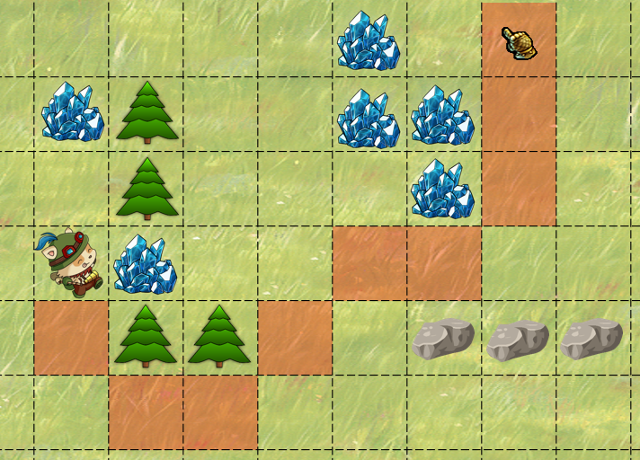
A* Shortest Path Algorithm
Live Coding Exercise (Lab)

Slide 55
Notable Greedy Algorithms: Huffman
The prefix tree generation algorithm in Huffman coding is greedy
Greedy: pick the two smallest-value leaves/nodes and combine them
Left move: 0, Right move: 1
100
1
A: 00
B: 100
C: 01
D: 1010
E: 11
F: 1011
0
54
0
27
1
0
1
46
15
0
1
0
1
Frequency % | 22 | 12 | 24 | 6 | 27 | 9
Symbol | A | B | C | D | E | F

Slide 56
References & Further Reading
Recommended further reading on greedy algorithms:
Lecture @ Boston University (Shang-Hua Teng)
www.cs.bu.edu/~steng/teaching/Fall2003/lectures/lecture7.ppt
Lecture @ University of Pennsylvania
www.cis.upenn.edu/~matuszek/cit594-2005/Lectures/36-greedy.ppt
Book on Algorithms @ Berkeley University
www.cs.berkeley.edu/~vazirani/algorithms/chap5.pdf
Book "Programming = ++ Algorithms;" – Chapter 9
www.programirane.org

Slide 57

Summary
Greedy algorithms make local optimal decision at each step and expect to achieve the global optimal solution
Greedy algorithms give optimal solution for problems holding:
Greedy choice & optimal substructure
Optimal greedy algorithms:
Max Coins, Sum of Coins, Activity Selection
Heuristic algorithms give approximation
Not always the optimal solution
E.g. the Set Cover Problem greedy is not optimal

Slide 58









Greedy Algorithms
https://softuni.bg/trainings/1331/algorithms-april-2016

Slide 59
License
This course (slides, examples, labs, videos, homework, etc.) is licensed under the "Creative Commons Attribution-NonCommercial-ShareAlike 4.0 International" license
Attribution: this work may contain portions from
"Fundamentals of Computer Programming with C#" book by Svetlin Nakov & Co. under CC-BY-SA license
"Data Structures and Algorithms" course by Telerik Academy under CC-BY-NC-SA license

Slide 60





Free Trainings @ Software University
Software University Foundation – softuni.org
Software University – High-Quality Education, Profession and Job for Software Developers
softuni.bg
Software University @ Facebook
facebook.com/SoftwareUniversity
Software University @ YouTube
youtube.com/SoftwareUniversity
Software University Forums – forum.softuni.bg

